Slide 1
Restricting and Sorting Data
Course Code: CSC 2108
Course Title: Introduction To Database
Department of Computer Science
Faculty of Science and Technology
Lecture No: | 04 | Week No: | 02 | Semester: | Summer 2019-2020
Lecturer: | Kawser Irom Rushee & rushee@aiub.edu

Slide 2
Lecture Outline
The process to limit the rows retrieved by a query
The process to sort the rows retrieved by a query

Slide 3
Limiting Rows Using a Selection
EMP
EMPNO ENAME JOB ... DEPTNO
7839 KING PRESIDENT 10
7698 BLAKE MANAGER 30
7782 CLARK MANAGER 10
7566 JONES MANAGER 20
...
"…retrieve all employees in department 10"
EMP
EMPNO ENAME JOB ... DEPTNO
7839 KING PRESIDENT 10
7782 CLARK MANAGER 10
7934 MILLER CLERK 10

Slide 4
Limiting Rows Selected
Restrict the rows returned by using the WHERE clause.
The WHERE clause follows the FROM clause
SELECT [DISTINCT] {*| column [alias], ...}
FROM table
[WHERE condition(s)];

Slide 5
Using the WHERE Clause
SQL> SELECT ename, job, deptno
2 FROM emp
3 WHERE job='CLERK';
ENAME JOB DEPTNO
---------- --------- ---------
JAMES CLERK 30
SMITH CLERK 20
ADAMS CLERK 20
MILLER CLERK 10

Slide 6
Character Strings and Dates
Character strings and date values are enclosed in single quotation marks.
Character values are case sensitive and date values are format sensitive.
The default date format is DD-MON-YY.
SQL> SELECT ename, job, deptno
2 FROM emp
3 WHERE ename = 'JAMES';

Slide 7
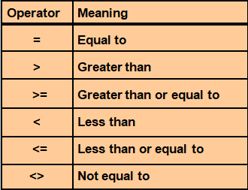
Comparison Operators

Slide 8
Using the Comparison Operators
SQL> SELECT ename, sal, comm
2 FROM emp
3 WHERE sal<=comm;
ENAME SAL COMM
---------- --------- ---------
MARTIN 1250 1400

Slide 9
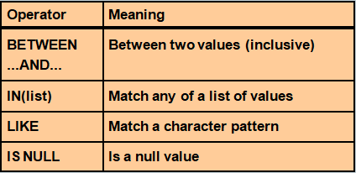
Other Comparison Operators

Slide 10
Using the BETWEEN Operator
Use the BETWEEN operator to display rows based on a range of values.
SQL> SELECT ename, sal
2 FROM emp
3 WHERE sal BETWEEN 1000 AND 1500;
ENAME SAL
---------- ---------
MARTIN 1250
TURNER 1500
WARD 1250
ADAMS 1100
MILLER 1300
Lower limit
Higher limit

Slide 11
Using the IN Operator
Use the IN operator to test for values in a list.
SQL> SELECT empno, ename, sal, mgr
2 FROM emp
3 WHERE mgr IN (7902, 7566, 7788);
EMPNO ENAME SAL MGR
--------- ---------- --------- ---------
7902 FORD 3000 7566
7369 SMITH 800 7902
7788 SCOTT 3000 7566
7876 ADAMS 1100 7788

Slide 12
Using the LIKE Operator
Use the LIKE operator to perform wildcard searches of valid search string values.
Search conditions can contain either literal characters or numbers.
-> % denotes zero or many characters.
-> _ denotes one character.
SQL> SELECT ename
2 FROM emp
3 WHERE ename LIKE 'S%';

Slide 13
Using the LIKE Operator
You can combine pattern-matching characters.
You can use the ESCAPE identifier to search for "%" or "_".
SQL> SELECT ename
2 FROM emp
3 WHERE ename LIKE '_A%';
ENAME
----------
MARTIN
JAMES
WARD

Slide 14
Using the IS NULL Operator
Test for null values with the IS NULL operator.
SQL> SELECT ename, mgr
2 FROM emp
3 WHERE mgr IS NULL;
ENAME MGR
---------- ---------
KING

Slide 15
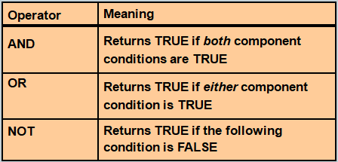
Logical Operators

Slide 16
Using the AND Operator
AND requires both conditions to be TRUE.
SQL> SELECT empno, ename, job, sal
2 FROM emp
3 WHERE sal>=1100
4 AND job='CLERK';
EMPNO ENAME JOB SAL
--------- ---------- --------- ---------
7876 ADAMS CLERK 1100
7934 MILLER CLERK 1300

Slide 17
Using the OR Operator
OR requires either condition to be TRUE.
SQL> SELECT empno, ename, job, sal
2 FROM emp
3 WHERE sal>=1100
4 OR job='CLERK';
EMPNO ENAME JOB SAL
--------- ---------- --------- ---------
7839 KING PRESIDENT 5000
7698 BLAKE MANAGER 2850
7782 CLARK MANAGER 2450
7566 JONES MANAGER 2975
7654 MARTIN SALESMAN 1250
...
7900 JAMES CLERK 950
...
14 rows selected.

Slide 18
Using the NOT Operator
SQL> SELECT ename, job
2 FROM emp
3 WHERE job NOT IN ('CLERK','MANAGER','ANALYST');
ENAME JOB
---------- ---------
KING PRESIDENT
MARTIN SALESMAN
ALLEN SALESMAN
TURNER SALESMAN
WARD SALESMAN

Slide 19
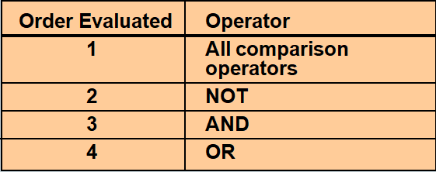
Rules of Precedence
Override rules of precedence by using parentheses.

Slide 20
Rules of Precedence
Use parentheses to force priority.
SQL> SELECT ename, job, sal
2 FROM emp
3 WHERE (job='SALESMAN'
4 OR job='PRESIDENT')
5 AND sal>1500;
ENAME JOB SAL
---------- --------- ---------
KING PRESIDENT 5000
ALLEN SALESMAN 1600

Slide 21
Rules of Precedence
SQL> SELECT ename, job, sal
2 FROM emp
3 WHERE job='SALESMAN'
4 OR job='PRESIDENT'
5 AND sal>1500;
ENAME JOB SAL
---------- --------- ---------
KING PRESIDENT 5000
MARTIN SALESMAN 1250
ALLEN SALESMAN 1600
TURNER SALESMAN 1500
WARD SALESMAN 1250

Slide 22
ORDER BY Clause
Sort rows with the ORDER BY clause
->ASC: ascending order, default
->DESC: descending order
The ORDER BY clause comes last in the SELECT statement.
SQL> SELECT ename, job, deptno, hiredate
2 FROM emp
3 ORDER BY hiredate;
ENAME JOB DEPTNO HIREDATE
---------- --------- --------- ---------
SMITH CLERK 20 17-DEC-80
ALLEN SALESMAN 30 20-FEB-81
...
14 rows selected.

Slide 23
Sorting in Descending Order
SQL> SELECT ename, job, deptno, hiredate
2 FROM emp
3 ORDER BY hiredate DESC;
ENAME JOB DEPTNO HIREDATE
---------- --------- --------- ---------
ADAMS CLERK 20 12-JAN-83
SCOTT ANALYST 20 09-DEC-82
MILLER CLERK 10 23-JAN-82
JAMES CLERK 30 03-DEC-81
FORD ANALYST 20 03-DEC-81
KING PRESIDENT 10 17-NOV-81
MARTIN SALESMAN 30 28-SEP-81
...
14 rows selected.

Slide 24
Sorting in Column Alias
SQL> SELECT empno, ename, sal*12 annsal
2 FROM emp
3 ORDER BY annsal;
EMPNO ENAME ANNSAL
--------- ---------- ---------
7369 SMITH 9600
7900 JAMES 11400
7876 ADAMS 13200
7654 MARTIN 15000
7521 WARD 15000
7934 MILLER 15600
7844 TURNER 18000
...
14 rows selected.

Slide 25
Sorting by Multiple Columns
The order of ORDER BY list is the order of sort.
SQL> SELECT ename, deptno, sal
2 FROM emp
3 ORDER BY deptno, sal DESC;
ENAME DEPTNO SAL
---------- --------- ---------
KING 10 5000
CLARK 10 2450
MILLER 10 1300
FORD 20 3000
...
14 rows selected.
You can sort by a column that is not in the SELECT list.

Slide 26
Books
Modern Database Management (Sixth Edition) by Fred R. McFadden, Jeffrey A. Hoffer, Mary B. Prescott
Database System Concepts (Fifth Edition) by Henry F. Korth, S. Sudarshan, A. Silberschatz
Oracle-database-10g-sql-fundamentals-1-student-guide-volume-1
SQL and Relational Theory: How to Write Accurate SQL Code by C.J. Date
Database Systems: A Practical Approach to Design, Implementation and Management (4th Edition) by Thomas M. Connolly, Carolyn E. Begg
Fundamentals of Database Systems, 5th Edition by RamezElmasri, Shamkant B. Navathe
Database Design and Relational Theory: Normal Forms and All That Jazz by C. J. Date
An Introduction to Database Systems 8th Edition, by C.J. Date

Slide 27
References
https://www.db-book.com/db6/slide-dir/index.html
https://docs.oracle.com/en/database/oracle/oracle-database/20/sqlrf/SQL-Standards.html#GUID-BCCCFF75-D2A4-43AD-8CAF-C3C97D92AC63
https://www.slideshare.net/HaaMeemMohiyuddin1/data-knowledge-and-information
https://www.slideshare.net/tabinhasan/from-data-to-wisdom
https://www.slideshare.net/thinnaphat.bo/

